Slide 1
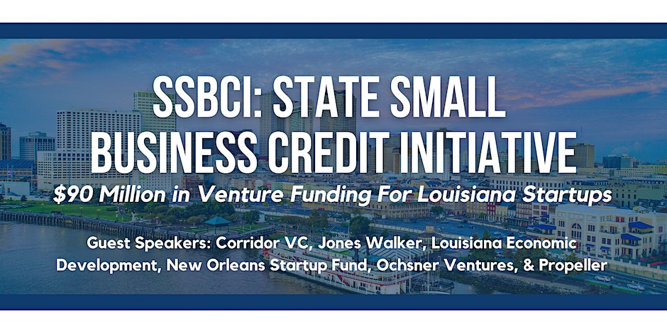
Hosted By:
With Support From:

Slide 2
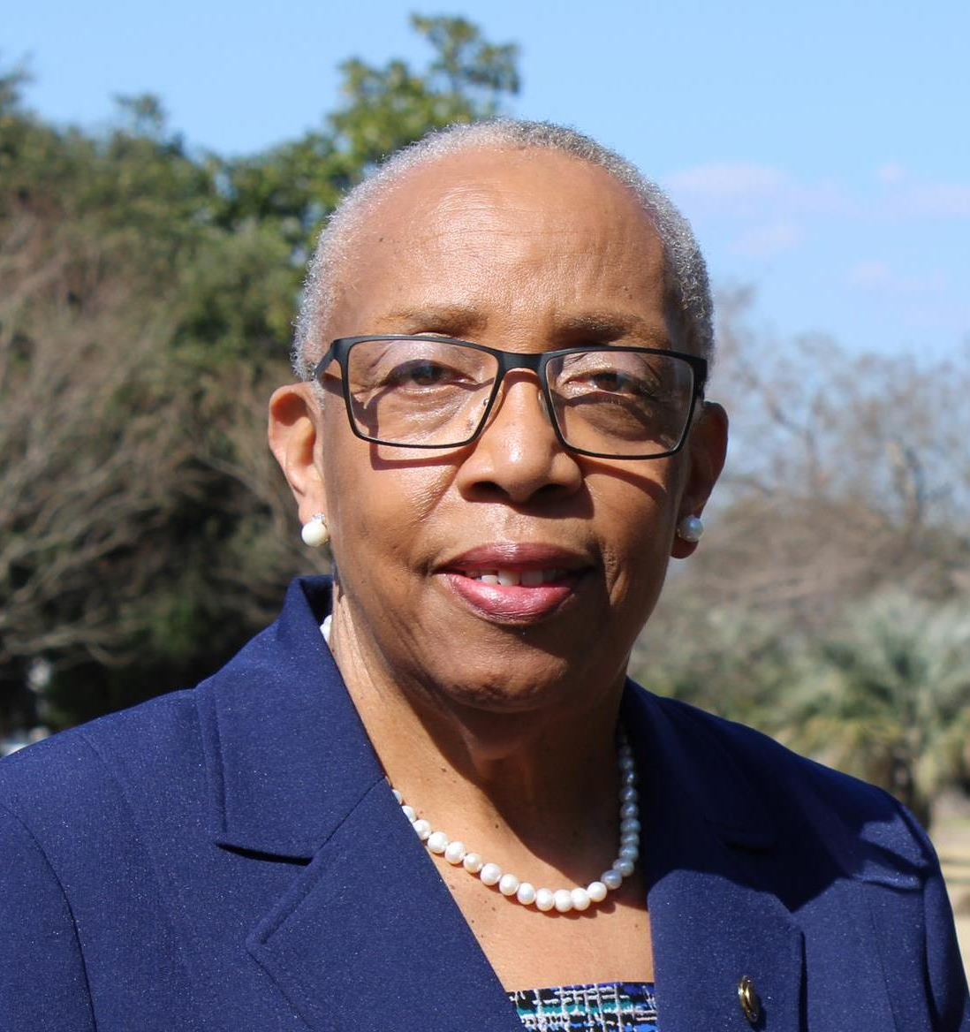
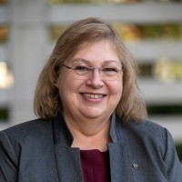
Session: Overview of the SSBCI Program
Brenda Guess
Assistant Secretary,
Louisiana Economic Development
Susan Bigner
Business Development Officer,
Louisiana Economic Development

Slide 3
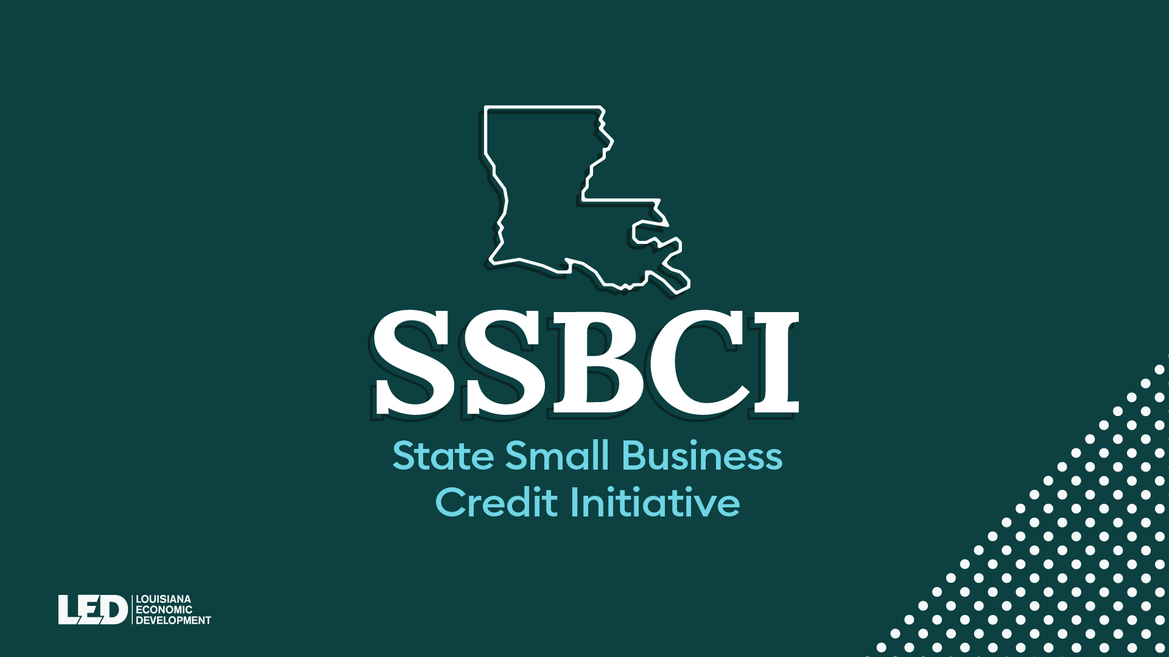

Slide 5
Louisiana SSBCI Loan Providers
LED Preferred MLP Lenders:
Carter Credit Union
Essential Credit Union
JEDCO
Lendistry
NewCorp, Inc.
NOLABA
LED Preferred Lenders: (CSP & SBLGP)
Bank of St. Francisville
Caldwell Bank
Citizens Bank & Trust of Vivian
Citizens Progressive Bank
Currency Bank
Evangeline Bank
First Guaranty Bank
NewCorp (GTY only)

Slide 6
Louisiana SSBCI Equity Providers
Seed Providers:
100 Black Angels & Allies
Biomedical Research Foundation
Boot64 Ventures
E2JDJ Delta, LP
Greater New Orleans Development Foundation
Grind Capital
Innovation Catalyst Inc./Greaux Innovation Ventures
VC Providers:
Biomedical Research Foundation
Callais Capital Management
Jefferson Louisiana Impact Venture Fund
LSU Health Foundation Venture Capital Innovation Fund
LSU Tiger Fund
Ochsner Ventures
Reconstruction Special Fund, LLC
LSU Bengal Fund
LSU Health Foundation
Minerva Capital
New Orleans BioFund
New Orleans Startup Fund
Ochsner Ventures
Opportunity Machine
Propeller
Revelry Ventures
The Idea Village
Tulane Innovation Institute

Slide 7
Louisiana SSBCI
Find Out More
Call 1-833-457-0531
or
Send a massage to LEDSSBCI2@la.gov
Or
Visit the website at www.LouisianaSSBCI.com

Slide 8
Session: Key Considerations for Companies Receiving Funding
Ted Jones
Partner, Jones Walker

Slide 9
SSBCI Program
Key Considerations for Companies Receiving Funding
Attorney Name
Theodore (Ted) W. Jones, Partner
AUGUST 3RD, 2023

Slide 10
SSBCI 2.0 – Under the American Rescue Plan Act of 2021 (ARPA)
Federal program administered by Treasury and implemented through “jurisdictions” (i.e., State of LA through LEDC)
To provide $10 billion to fund the State Small Business Credit Initiative (SSBCI) as a response to the economic effects of the COVID-19 pandemic.
2 program categories: Capital Access Programs (CAPs) and Other Credit Support Programs (OCSPs).
“Jurisdiction-sponsored equity/venture capital programs”
Direct investments of SSBCI funds in small bus alongside co-investments
SSBCI investments in “venture capital funds” that invest in small bus
LEDC has mandated the use of “venture capital funds.”
Practical effect . . . different than SSBCI 1.0

Slide 11
SSBCI “investors” – SSBCI “investees”
SSBCI “investors” – the venture capital funds that pool private capital with SSBCI funds to make investments in SSBCI “investees”
SSBCI “investees” – the operating companies/businesses that receive investment from SSBCI “investors”
Likely investment round structures:
Priced equity, usually as preferred stock or units
Convertible Debt (“equity like”)
SAFE Instruments (not debt, not equity, but conditional right to buy future equity)
KISSes (rolled out a few years back with SAFEs, but not really used)

Slide 12
Fundamental SSBCI “investee” Qualification(s)
Must be – a small business located in Louisiana having 500 or fewer employees (a qualified business).
LEDC highly encourages SSBCI “investors” to invest in – qualified businesses which employ 10 or fewer employees, including independent contractors and sole proprietors (“Very Small Businesses”) and/or businesses owned by one or more socially and economically disadvantaged individuals (a “SEDI-Owned Business”).
SEDI-Owned Business and CDFI Investment Area Definitions – See next slide.

Slide 13
SEDI-Owned Business & CDFI Investment Area
SEDI-Owned Business: any business enterprise that: (1) certifies it is owned and controlled by individuals who have had their access to credit on reasonable terms diminished as compared to others in comparable economic circumstances, due to their (a) membership of a group that has been subjected to racial or ethnic prejudice or cultural or cultural bias with American society, (b) gender, (c) veteran status, (d) limited English proficiency, (e) physical handicap, (f) long-term residence in an environment isolated from the mainstream of American society, (g) membership of a federally or state-recognized Indian Tribe, (h) long-term residence in a rural community, (i) residence in a U.S. territory, (j) residence in a community undergoing economic transition (including communities impacted by the shift towards a net-zero economy or deindustrialization), or (k) membership of another “underserved community” as defined in U.S. Executive Order 13985; (2) certifies it is owned and controlled by individuals whose residences are in CDFI Investment Areas; (3) certifies it will operate a location in a CDFI Investment Area; or (4) is located in a CDFI Investment Area.
CDFI Investment Area: any area defined by a Community Development Financial Institution (CDFI) which is generally a low-income, high poverty geography that receives neither sufficient access to capital nor support for the needs of small businesses, including minority-owned businesses.

Slide 14
How does a SSBCI “investee” get the investment capital in the door?
CERTIFICATIONS
Use of Proceeds - non-passive; non-lobbying; non-speculative business purpose
Conflicts of Interest – General Rule; “SSBCI Insider” status
Sex Offender
SEDI-Owned Business status (optional)
Demographics-Related Data (optional)
OTHER DISCLOSURES – Equity Transaction Checklist
Bus Info: SSBCI “investee” name, address, EIN, form of org, year opened, revenue, net income, jobs retained, jobs created, full-time and part-time employees
Documents: SSBCI “investee” authorizations (minutes/consents), investment documents, pre/post cap table, fund services
Transaction Info: primary and secondary purposes of investment, climate/energy aligned or impacted, investment/round amount, list of investors

Slide 15
What to expect post-investment? – ongoing and timely reporting . . . .
FINANCIAL REPORTING
SSBCI “investors” must annually provide to LEDC a statement of financial condition, fund net worth and audited financial statements (120 days after FYE).
SSBCI “investees” may not need audited financials themselves, but should be prepared to provide very detailed, accurate and timely financial information to SSBCI “investors” and their auditors so that they can deliver audited financials for participating venture capital funds.
Valuing “Level 3” (iiliquid) assets for GAAP is difficult, time consuming and costly.
Any SSBCI “investee” that is taxed as a partnership (LLC, etc.) must not be delayed with K-1s (Feb 15 deadline).
ADDITIONAL REPORTING – Quarterly and Annually
LEDC obligations drive SSBCI “investor” obligations: https://home.treasury.gov/policy-issues/small-business-programs/state-small-business-credit-initiative-ssbci.
SSBCI “investors” must provide LEDC with quarterly reports within 10 days after FQE and annual reports within 45 days after FYE (no later than Feb 15).
SSBCI “investees” will have to get SSBCI “investors” as much information when and as needed for them to remain in compliance with quarterly and annual reporting requirements.

Slide 16
Session: Supporting SSBCI As An Ecosystem
Kelli Saulny
Co-Founder,
Corridor Ventures
Aimee Quirk
CEO, Ochsner Ventures
Ochsner Health
Jimmy Roussel
CEO,
New Orleans Startup Fund
Patrick Hernandez
Director of Capital Access,
Propeller

